Slide 1


Slide 2

Big (O) Notation

Slide 3

Big (O)? What is all this?
How do we measure the efficiency of an algorithm? Do we simply look at execution time and measure it in seconds?? Or computational space?
When trying to characterize an algorithm’s efficiency, it is important to quantify the number of operations or steps that the algorithm will require.
Order of Growth Big(O) defines how the program would behave as the order of size of input is increased.
Let’s unpack all this.

Slide 4
The algorithm of Summation
If we wanted to understand the number of steps required to add 100 numbers in Python.
Lets’ count the number of assignments. The number of assignment statements is 1 (j=0) plus the value of n (the number of times we perform j=j+i). We can denote this by a function, call it T, where T(n)=1+n.
def addition(n): j = 0 for i in range(n+1): j = j + i return j

Slide 5
Big (O), Order of Magnitude
We can then say that the sum of the first 100 integers is a bigger instance of the summation problem than the sum of the first 10 since there are more steps.
It turns out that the exact number of operations is not as important as determining the most dominant part of the T(n) function. In other words, as the problem gets larger, some portion of the T(n) function tends to overpower the rest. What is this portion for the addition algorithm??
The order of magnitude function describes the part of T(n) that increases the fastest as the value of n increases. Order of magnitude is often called Big-O notation (for “order”).

Slide 6
Big (O), Order of Magnitude
def func(n): a=5 b=6 c=10 for i in range(n): for j in range(n): x = i * i y = j * j z = i * j for k in range(n): w = a*k + 45 v = b*b d = 3
3 constant terms
3 assignments performed n² times.
2 assignments performed n times and 1 constant term

Slide 7
Common Magnitudes
g(n) | Name
1 | Constant
O(N) | Linear
O(Log N) | Logarithmic
O(N Log N) | Log-Linear
O(N²) | Quadratic
O(N³) | Cubic

Slide 8
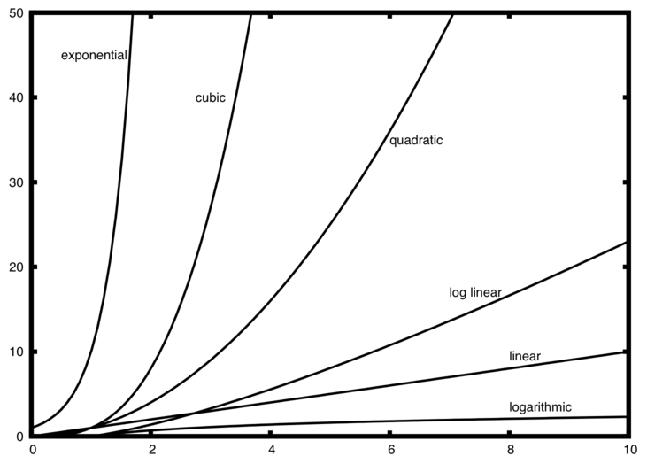
Common Magnitudes

Slide 9
Challenge: Compute the complexity
def power_of_2(a): x = 0 while a > 1: a = a/2 x = x+1 return x

Slide 10
Now that we know Big O...lets talk about memory
Each time you want to store an item in memory, you ask the computer for some space, and it gives you an address where you can store your item.
If you want to store multiple items, there are two basic ways to do so: arrays and lists.
Arrays and lists are examples of data structures.

Slide 11
What is a data structure?
An abstract data type, sometimes abbreviated ADT, is a logical description of how we view the data (the state) and the operations that are allowed (behaviour) without regard to how they will be implemented. The implementation of an abstract data type, often referred to as a data structure, will require that we provide a physical view of the data using some collection of programming constructs and primitive data types.

Slide 12
Data Structure: Arrays
Arrays are a collection structure or a data structure where our tasks are stored contiguously (right next to each other) in memory.
If we have an array with four elements, we would ask the computer for a chunk of memory that can fit four tasks. I
f you added an element to the array, you are out of space and need to move to a new spot in memory every time, adding a new item will be really slow.

Slide 13
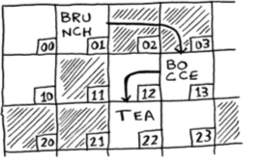
Linked lists: A better implementation
With linked lists, your items can be anywhere in memory. Each item stores the address of the next item in the list. So, a bunch of random memory addresses are linked together.
Notes:
With linked lists, you never have to move your items
With linked lists, you never have to move your items

Slide 14
Linked lists: Problems
Linked lists have a similar problem. Suppose you want to read the last item in a linked list. You can’t just read it, because you don’t know what address it’s at.
Arrays are great if you want to read random elements, because you can look up any element in your array instantly. With a linked list, the elements aren’t next to each other.

Slide 15
Inserting in the middle
How would we insert an element in the middle of a data structure. That is we want a certain order so we care about where middle is.
In an array, we would have to shift half the items down and now request for another chunk of memory.
In a linked list ,however, it’s as easy as changing what the previous element points to.

Slide 16
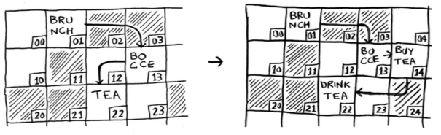
Inserting in the middle

Slide 17
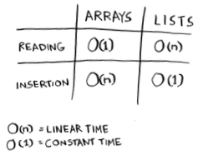
Array vs Linked List: Run times

Slide 18

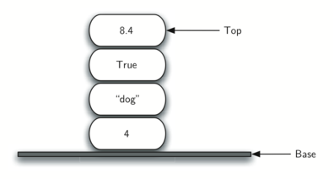
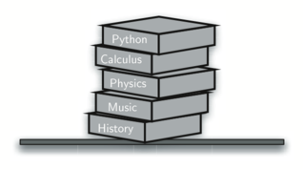
What’s a Stack?
A Stack is an ordered collection of items where the addition of new items and the removal of existing items always takes place at the same end. This end is commonly referred to as the “top.” The end opposite the top is known as the “base.”

Slide 19
Useful properties of Stack’s
One of the most useful ideas related to stacks comes from the simple observation of items as they are added and then removed. Assume you start out with a clean desktop. Now place books one at a time on top of each other. You are constructing a stack.
Consider what happens when you begin removing books. The order that they are removed is exactly the reverse of the order that they were placed. Stacks are fundamentally important, as they can be used to reverse the order of items.
Example every web browser has a Back button. As you navigate from web page to web page, those pages are placed on a stack (actually it is the URLs that are going on the stack). The current page that you are viewing is on the top and the first page you looked at is at the base.

Slide 20
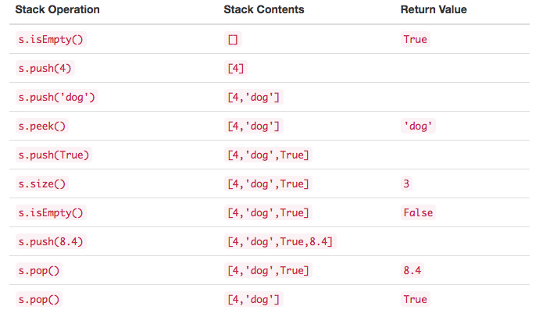
Stack Abstract Data Type
The Stack abstract data type is defined by the following structure and operations.

Slide 21
Concrete Application of Stack
Where are Stacks used you ask?
Integer values are common data items. The decimal number 233₁₀ and its corresponding binary equivalent 11101001₂ are interpreted respectively as 2×10²+3×10¹+3×10⁰
and
1×2⁷+1×2⁶+1×2⁵+0×2⁴+1×2³+0×2²+0×2¹+1×2⁰
But how can we easily convert integer values into binary numbers? The answer is an algorithm called “Divide by 2” that uses a stack to keep track of the digits for the binary result.

Slide 22
Stack for Decimal number → Binary
The Divide by 2 algorithm assumes that we start with an integer greater than 0. A simple iteration then continually divides the decimal number by 2 and keeps track of the remainder.
The first division by 2 gives information as to whether the value is even or odd. An even value will have a remainder of 0. It will have the digit 0 in the ones place. An odd value will have a remainder of 1 and will have the digit 1 in the ones place. We think about building our binary number as a sequence of digits; the first remainder we compute will actually be the last digit in the sequence. we again see the reversal property that signals that a stack is likely to be the appropriate data structure for solving the problem.

Slide 23
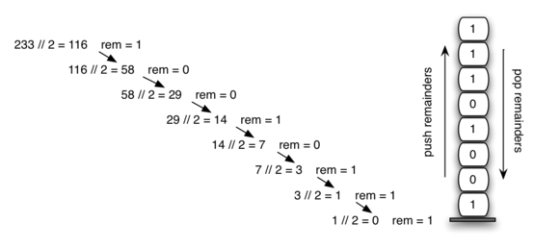
Stack for Decimal number → Binary
Notes:
The function divideBy2 takes an argument that is a decimal number and repeatedly divides it by 2. Line 7 uses the built-in modulo operator, %, to extract the remainder and line 8 then pushes it on the stack. After the division process reaches 0, a binary string is constructed in lines creates an empty string. The binary digits are popped from the stack one at a time and appended to the right-hand end of the string. The binary string is then returned.

Slide 24
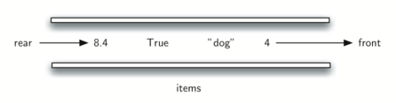
What are Queues?
A queue is an ordered collection of items where the addition of new items happens at one end, called the “rear,” and the removal of existing items occurs at the other end, commonly called the “front.” As an element enters the queue it starts at the rear and makes its way toward the front, waiting until that time when it is the next element to be removed.

Slide 25
A simple Application: Printer jobs
Your computer laboratory has 30 computers networked with a single printer. When students want to print, their print tasks “get in line” with all the other printing tasks that are waiting. The first task in is the next to be completed.

Slide 26
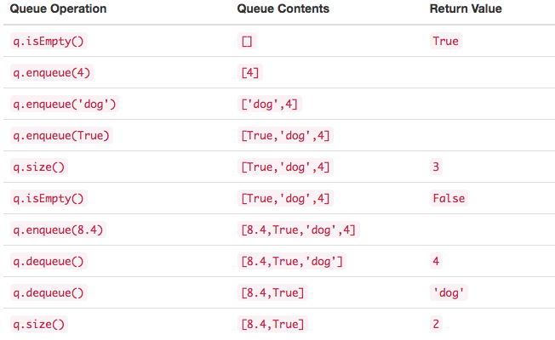
Queue Abstract Data Type
The queue abstract data type is defined by the following structure and operations

Slide 27
Searching and Sorting
Now that we have some data structures in mind, let us look into the most common activities we desire: searching and sorting.
Searching is the algorithmic process of finding a particular item in a collection of items. A search typically answers either True or False as to whether the item is present.
The question is, that how is such membership programmed under the hood:
>>> 15 in [3,5,2,4,1] # False

Slide 28

Searching and Sorting
In Python lists, these relative positions are the index values of the individual items. Since these index values are ordered, it is possible for us to visit them in sequence. This process gives rise to our first searching technique, the sequential search.

Slide 29
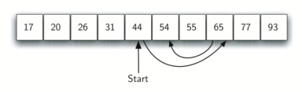
Searching and Sorting
Instead of searching the list in sequence, a binary search will start by examining the middle item. If that item is the one we are searching for, we are done. If it is not the correct item, we can use the ordered nature of the list to eliminate half of the remaining items.
What is the expected complexity here?
Notes:
Divide and conquer means that we divide the problem into smaller pieces, solve the smaller pieces in some way, and then reassemble the whole problem to get the result. When we perform a binary search of a list, we first check the middle item. If the item we are searching for is less than the middle item, we can simply perform a binary search of the left half of the original list. Likewise, if the item is greater, we can perform a binary search of the right half.
When we split the list enough times, we end up with a list that has just one item. Either that is the item we are looking for or it is not. Either way, we are done. The number of comparisons necessary to get to this point is i where n2i=1n2i=1. Solving for i gives us i=logn i=log(⁡n). The maximum number of comparisons is logarithmic with respect to the number of items in the list. Therefore, the binary search is O(logn)O(log⁡n).

Slide 30
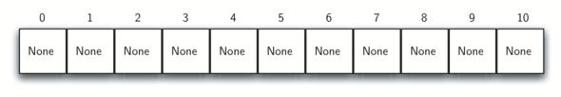
Searching and Sorting
A hash table is a collection of items which are stored in such a way as to make it easy to find them later. The mapping between an item and the slot where that item belongs in the hash table is called the hash function.
Each position of the hash table, often called a slot, can hold an item and is named by an integer value starting at 0.

Slide 31
First Hash Function: Remainder Method
Our first hash function, sometimes referred to as the “remainder method,” simply takes an item and divides it by the table size, returning the remainder as its hash value (h(item)=item%11)
So, if the item we want to add is 77 we get 77%11 = 0. This is our first position. If item 31, 31%11, we get 9.
This is referred to as the load factor, and is commonly denoted by λ=number of item/ stable size.
Now when we want to search for an item, we simply use the hash function to compute the slot name for the item and then check the hash table to see if it is present. Soo...what is the time complexity?

Slide 32
Good hash functions?
If the item 44 had been the next item in our collection, it would have a hash value of 0 (44%11==0). Since 77 also had a hash value of 0, we would have a problem. According to the hash function, two or more items would need to be in the same slot. This is referred to as a collision.
Our goal is to create a hash function that minimizes the number of collisions, is easy to compute, and evenly distributes the items in the hash table.

Slide 33
Good hash functions?
Folding Method of constructing hash functions begins by dividing the item into equal-size pieces (the last piece may not be of equal size). These pieces are then added together to give the resulting hash value. For example, if our item was the phone number 436-555-4601, we would take the digits and divide them into groups of 2 (43,65,55,46,01). After the addition, 43+65+55+46+01, we get 210. In this case 210 % 11 is 1, so the phone number 436-555-4601 hashes to slot 1.
Mid-square method. We first square the item, and then extract some portion of the resulting digits. For example, if the item were 44, we would first compute 44²=1,936. By extracting the middle two digits, 93, and performing the remainder step, we get 5 (93 % 11).

Slide 34
Sorting
Sorting is the process of placing elements from a collection in some kind of order. For example, a list of words could be sorted alphabetically or by length.
Two things to keep in mind: 1) it will be necessary to compare two values to see which is smaller or larger In order to sort a collection. It will also be necessary to have some systematic way to compare values to see if they are out of order. 2) when values are not in the correct position with respect to one another, it may be necessary to exchange them.

Slide 35
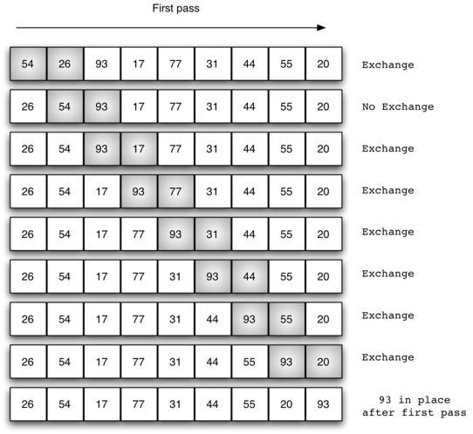
Sorting: Bubble Sort
It compares adjacent items and exchanges those that are out of order. Each pass through the list places the next largest value in its proper place

Slide 36
Sorting: Bubble Sort
A bubble sort is often considered the most inefficient sorting method since it must exchange items before the final location is known.

Slide 37
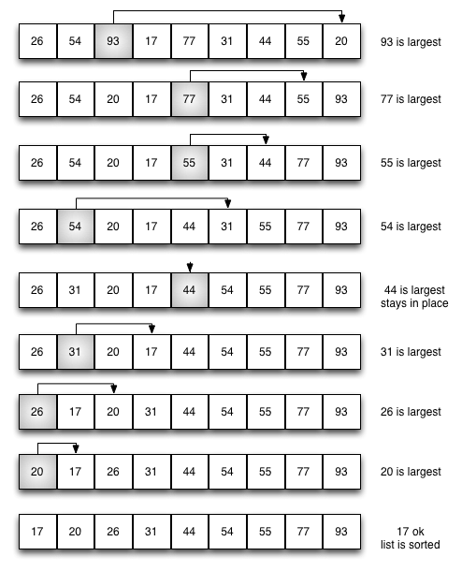
Sorting: Selection Sort
The selection sort improves on the bubble sort by making only one exchange for every pass through the list. In order to do this, a selection sort looks for the largest value as it makes a pass and, after completing the pass, places it in the end of the list.

Slide 39
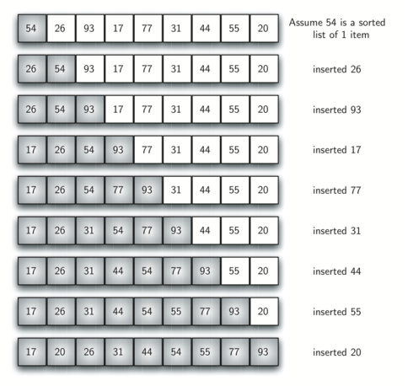
Sorting: Insertion Sort
We begin by assuming that a list with one item (position 0) is already sorted. On each pass, one for each item 1 through n−1, the current item is checked against those in the already sorted sublist. As we look back into the already sorted sublist, we shift those items that are greater to the right. When we reach a smaller item or the end of the sublist, the current item can be inserted.

Slide 41
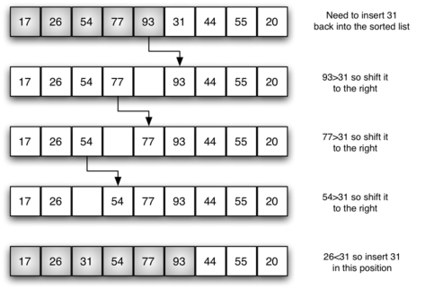
Sorting: Selection Sort

Slide 42


